Slide 1
Roman Art

Slide 2
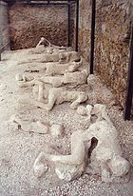
Garden of the Fugitives

Slide 3
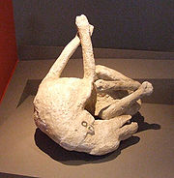
Pompeii Dog

Slide 4
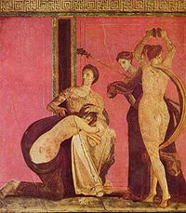
Pompeii Sadistic Initiation

Slide 5
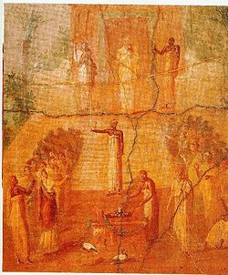
Pompeii Isis Ceremony

Slide 6
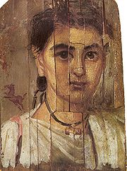
Fayyum Wood Painting

Slide 7
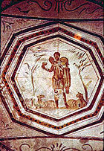
The Good Shepherd

Slide 8
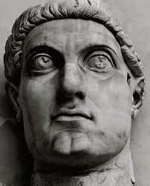
Constantine

Slide 9
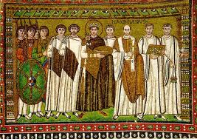
Justinian

Slide 10
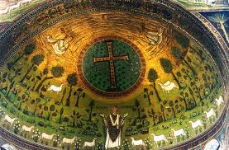
St. Apollinarius

Slide 11
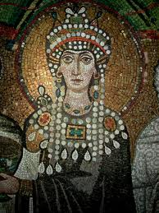
Theodora

Slide 12
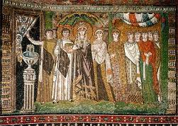
Theodora and Associates

